Slide 1
TDA Pipeline
Kunlin

Slide 2
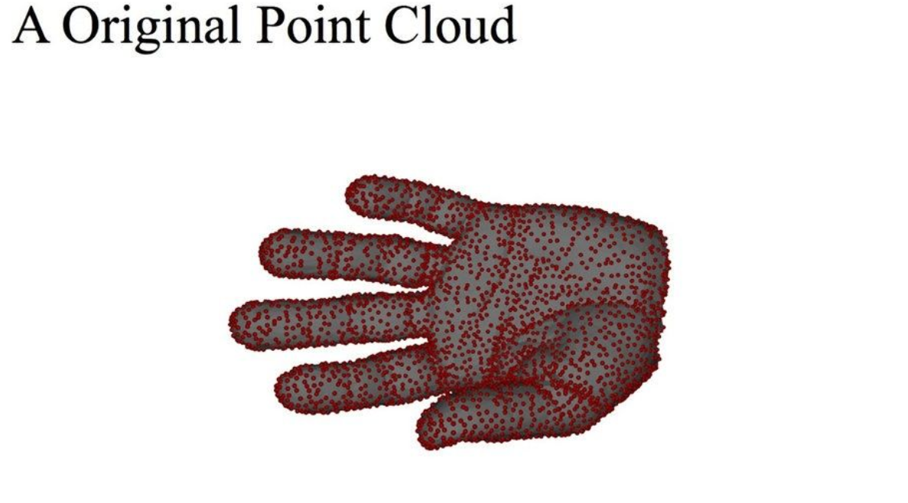
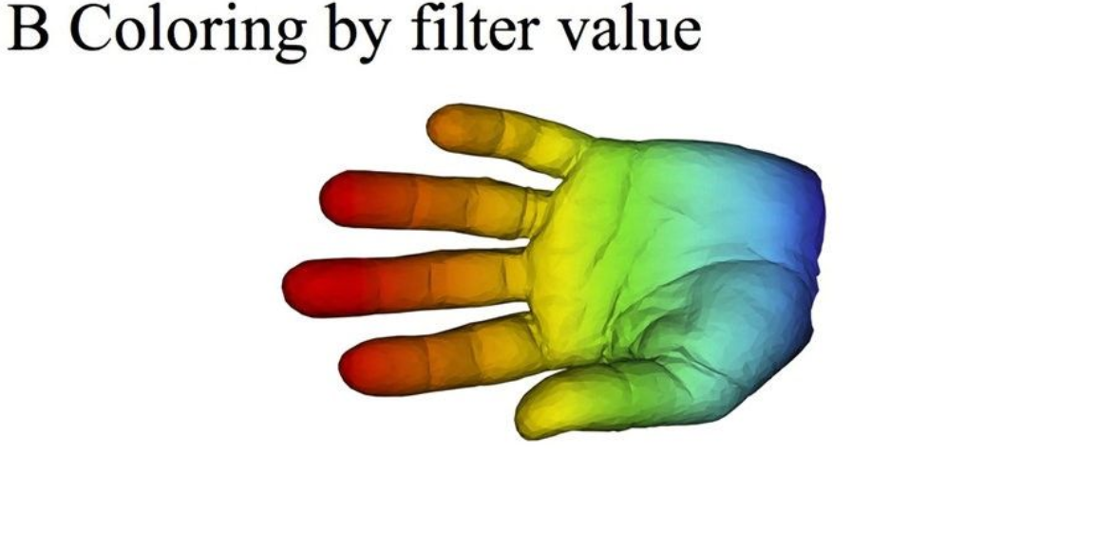
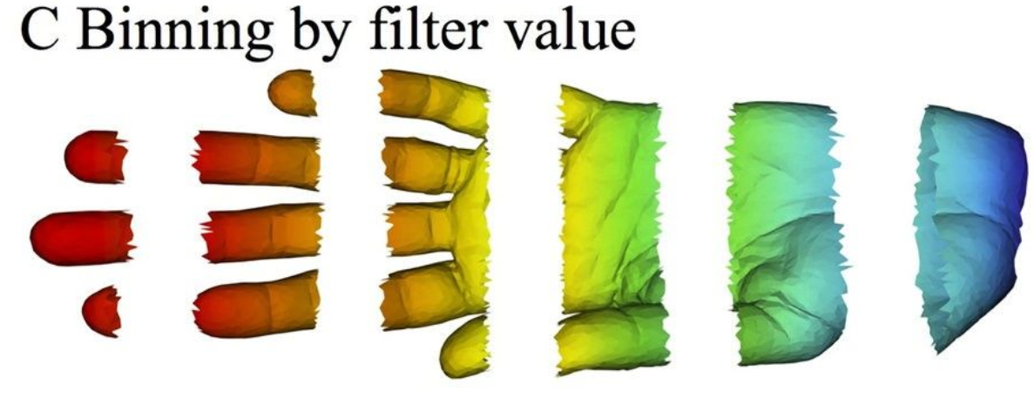
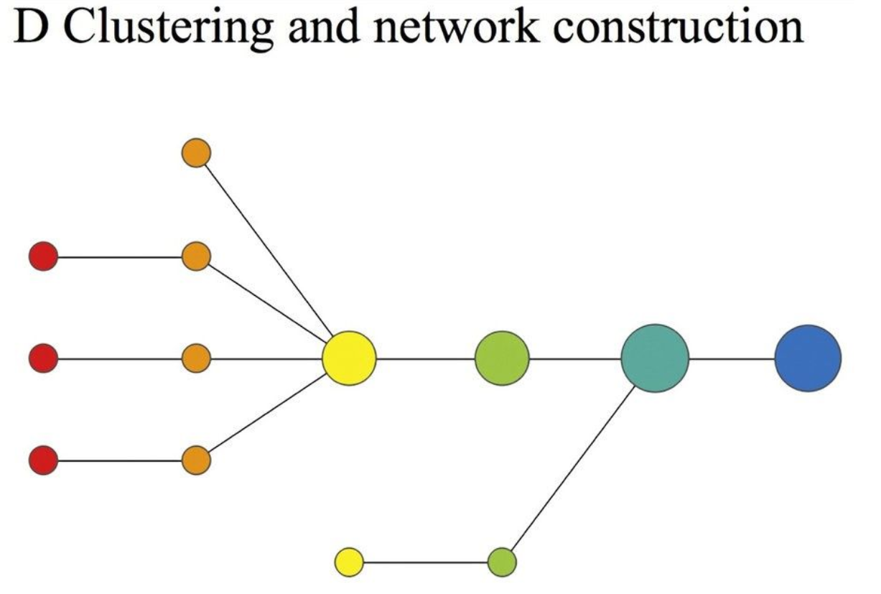
TDA Pipeline
Raw data => Summary of main features
Choose a dataset
Data representation
Data grouping
Network construction
Network/Graph feature extraction
Downstream task with other methods:
Statistics
Machine Learning
Operation Research
…
Notes:
https://www.youtube.com/watch?v=pW6nZXeWlGM&t=77s
https://www.youtube.com/watch?v=PCBTZh41Ris

Slide 3
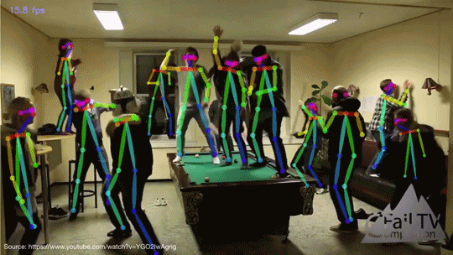
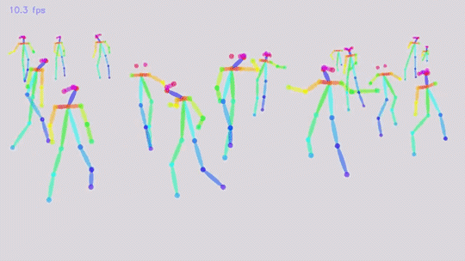
Pose Estimation

Slide 4
Graph Mining Network Analysis
Kunlin

Slide 5
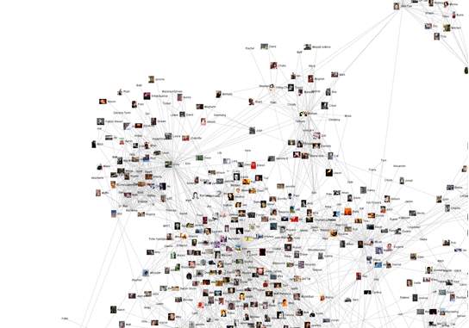
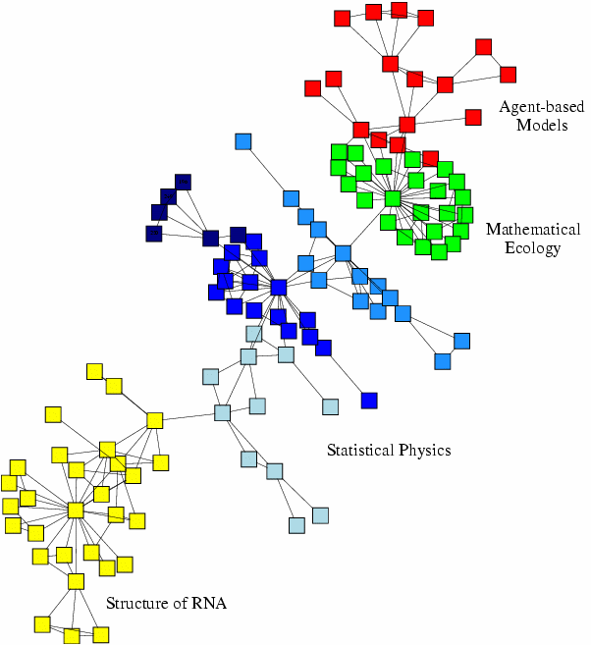
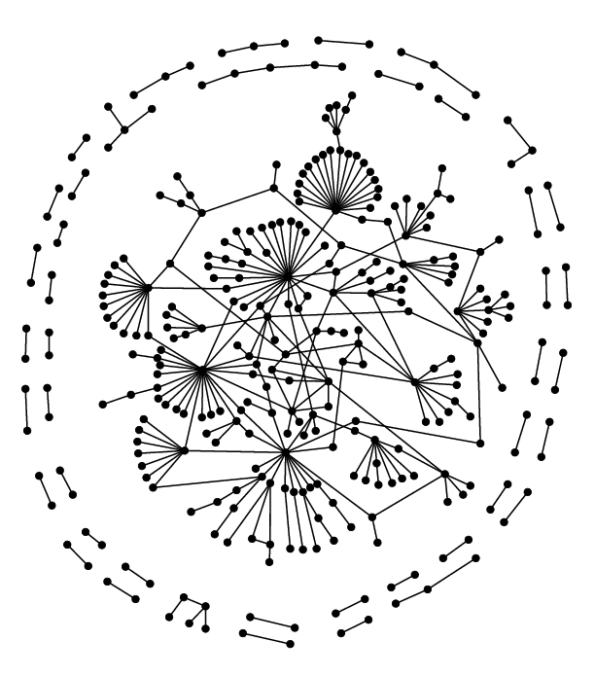
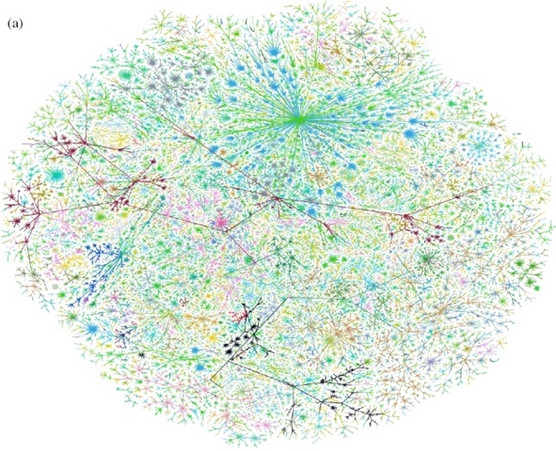
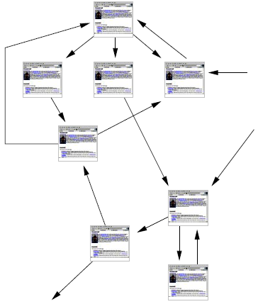
Many Data are Networks
Social networks
Economic networks
Biomedical networks
Information networks: Web & citations
Internet
Networks of neurons

Slide 6
Why Networks? Why Now?
Universal language for describing complex data
Networks from science, nature, and technology are more similar than one would expect
Shared vocabulary between fields
Computer Science, Social science, Physics, Economics, Statistics, Biology
Data availability (+computational challenges)
Web/mobile, bio, health, and medical
Impact!
Social networking, Social media, Drug design

Slide 7
Machine Learning with Networks
Classical ML tasks in networks:
Node classification
Predict a type of a given node
Link prediction
Predict whether two nodes are linked
Community detection
Identify densely linked clusters of nodes
Network similarity
How similar are two (sub)networks

Slide 8
Example: Node Classification
?
?
?
?
Machine Learning
?

Slide 9
Example: Node Classification
Classifying the function of proteins in the interactome!
Image from: Ganapathiraju et al. 2016. Schizophrenia interactome with 504 novel protein–protein interactions. Nature.

Slide 10
Example: Link Prediction
?
?
x
?
Machine Learning

Slide 11








Example: Link Prediction
Content recommendation is link prediction!
?

Slide 12
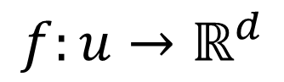
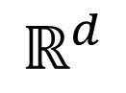
Feature Learning in Graphs
Goal: Efficient task-independent feature learning for machine learning in networks!
node
2
vec
u
$$f:u→ℝ^{d}$$
$$ℝ^{d}$$
Feature representation, embedding

Slide 13
Example
Zachary’s Karate Club Network:
Input
Output
Image from: Perozzi et al. 2014. DeepWalk: Online Learning of Social Representations. KDD.

Slide 14
Why Is It Hard?
But networks are far more complex!
Complex topographical structure (i.e., no spatial locality like grids)
No fixed node ordering or reference point (i.e., the isomorphism problem)
Often dynamic and have multimodal features.

Slide 15
Theoretical Bases

Slide 16
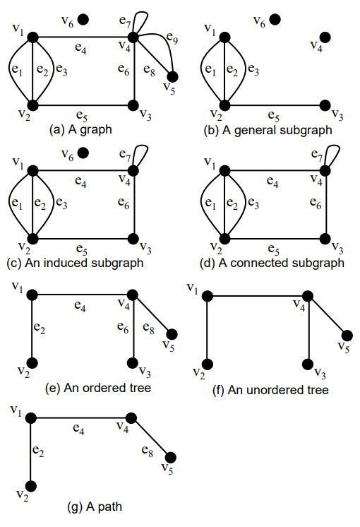
Subgraph Categories
After TDA, we get G(V, E, f)
V: set of vertices
E: set of edges
f: mapping E -> V*V
General subgraph: subset of V & E
Induced subgraph: subset of V
Connected subgraph
Ordered/Unordered tree
Path

Slide 17
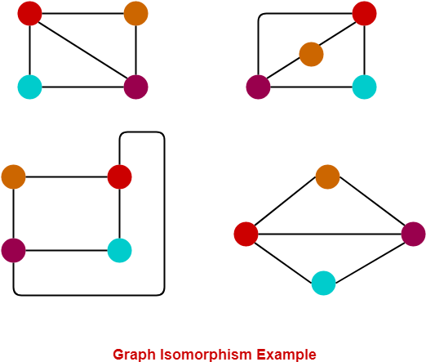
Subgraph Isomorphism
To ensure topological identity between graphs/subgraphs
Unknown computational complexity

Slide 18
Graph Invariants
Isomorphic -> Invariants
Example: # of vertices, degree of each vertex, # of loops
Usage: to reduce search space for isomorphic

Slide 19
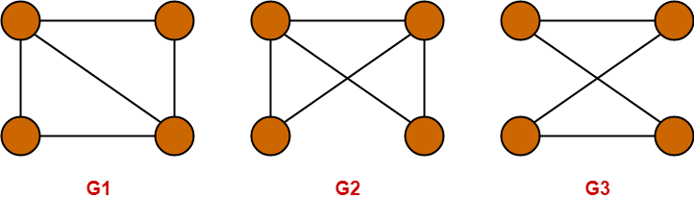
Subgraph Isomorphism Problem
Satisfy all of the following
Check # of vertices
Check # of edges
Check degree sequence
Check cycle of the same length
Satisfy at least one of the following
Complement graphs are isomorphic
Adjacency matrices are same
Subgraphs are isomorphic
Notes:
https://www.gatevidyalay.com/graph-isomorphism/

Slide 20
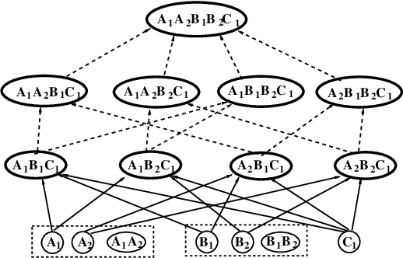
Solution Methods
Greedy search: Depth-first search & Breadth-first search
Inductive logic programming
Inductive database: subgraphs/relations stored in DB
Complete level-wise search
Support vector machine
Notes:
行星
购物篮模型 提前设定好相关物品

Slide 21
Node Embeddings

Slide 22
Embedding Nodes
Input
Output
Intuition: Find embedding of nodes to d-dimensions so that “similar” nodes in the graph have embeddings that are close together.

Slide 23
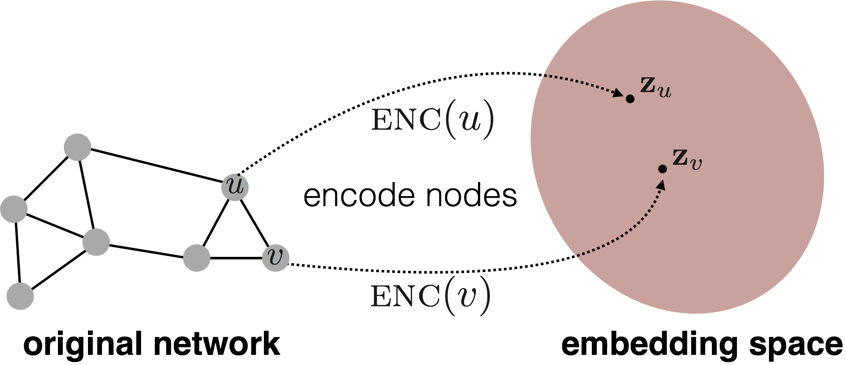
Setup
Assume we have a graph G:
V is the vertex set.
A is the adjacency matrix (assume binary).
No node features or extra information is used!
Goal is to encode nodes so that similarity in the embedding space (e.g., dot product) approximates similarity in the original network.

Slide 24
Embedding Nodes
Goal:
Need to define!

Slide 25
Learning Node Embeddings
Define an encoder (i.e., a mapping from nodes to embeddings)
Define a node similarity function (i.e., a measure of similarity in the original network).
Optimize the parameters of the encoder so that:
Notes:
Note that other distance measures other than dot products could be used (e.g., Euclidean distance), but the dot product is the standard measure of similarity used.

Slide 26
Two Key Components
Encoder maps each node to a low-dimensional vector.
Similarity function specifies how relationships in vector space map to relationships in the original network.
d-dimensional embedding
node in the input graph
Similarity of u and v in the original network
dot product between node embeddings
Notes:
Note again that other distance measures other than dot products could be used (e.g., Euclidean distance), but the dot product is the standard measure of similarity used.

Slide 27
“Shallow” Encoding
Simplest encoding approach: encoder is just an embedding-lookup
matrix, each column is node embedding [what we learn!]
indicator vector, all zeroes except a one in column indicating node v

Slide 28
“Shallow” Encoding
Simplest encoding approach: encoder is just an embedding-lookup
embedding vector for a specific node
embedding matrix
Dimension/size of embeddings
one column per node

Slide 29
“Shallow” Encoding
Simplest encoding approach: encoder is just an embedding-lookup.
i.e., each node is assigned a unique embedding vector.
E.g., node2vec, DeepWalk, LINE

Slide 30
How to Define Node Similarity?
Key distinction between “shallow” methods is how they define node similarity.
E.g., should two nodes have similar embeddings if they….
are connected?
share neighbors?
have similar “structural roles”?
…?

Slide 31
Adjacency-based Similarity

Slide 32
Adjacency-based Similarity
Similarity function is just the edge weight between u and v in the original network.
Intuition: Dot products between node embeddings approximate edge existence.
loss (what we want to minimize)
embedding similarity
(weighted) adjacency matrix for the graph
sum over all node pairs

Slide 33
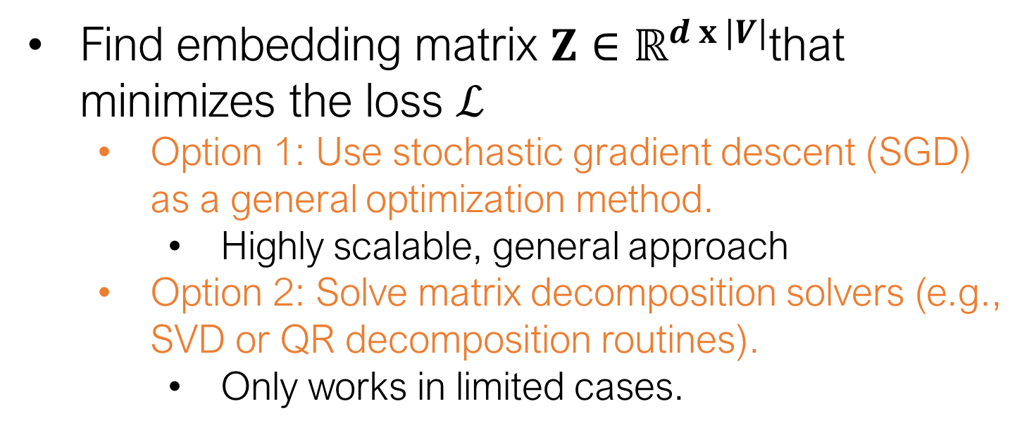
Adjacency-based Similarity
Find embedding matrix $Z∈ℝ^{d x |V|}$that minimizes the loss $ℒ$
Option 1: Use stochastic gradient descent (SGD) as a general optimization method.
Highly scalable, general approach
Option 2: Solve matrix decomposition solvers (e.g., SVD or QR decomposition routines).
Only works in limited cases.

Slide 34
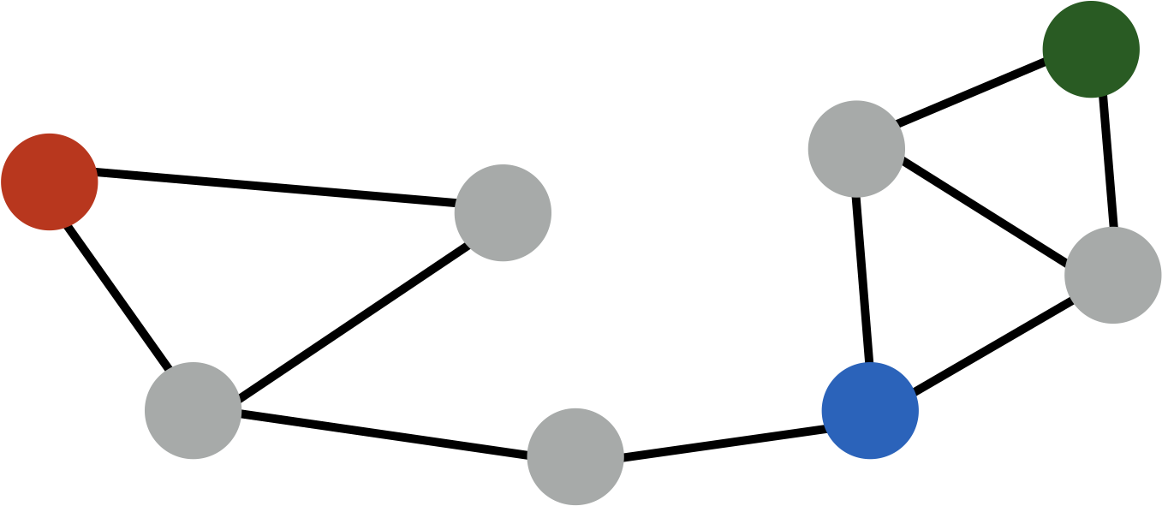
Adjacency-based Similarity
Drawbacks:
O(|V|²) runtime. (Must consider all node pairs.)
Can make O([E|) by only summing over non-zero edges and using regularization (e.g., Ahmed et al., 2013)
O(|V|) parameters! (One learned vector per node).
Only considers direct, local connections.
e.g., the blue node is obviously more similar to green compared to red node, despite none having direct connections.

Slide 35
Multi-hop Similarity

Slide 36
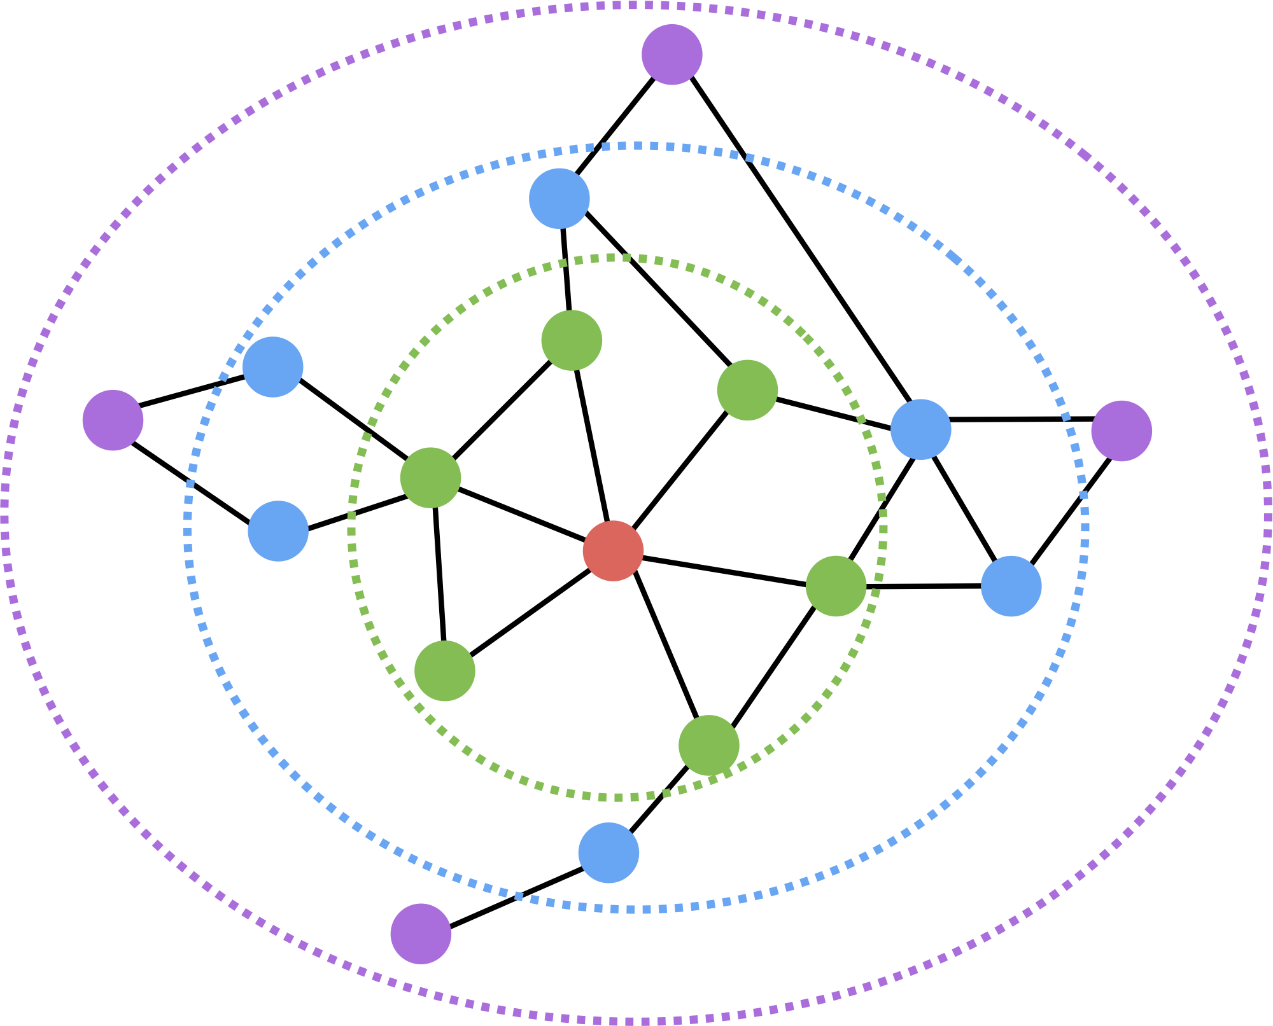
Multi-hop Similarity
Idea: Consider k-hop node neighbors.
E.g., two or three-hop neighbors.
Red: Target node
Green: 1-hop neighbors
A (i.e., adjacency matrix)
Blue: 2-hop neighbors
A²
Purple: 3-hop neighbors
A³

Slide 37
Multi-hop Similarity
Basic idea:
Train embeddings to predict k-hop neighbors.
In practice (GraRep from Cao et al, 2015):
Use log-transformed, probabilistic adjacency matrix:
Train multiple different hop lengths and concatenate output.
node degree
constant shift
Notes:
The max with 0 and the constant shift etc can be viewed as regularization. We only pay attention to nodes that have significantly high multi-hop adjacency counts. In probabilistic terms, this means that we have a high prior for nodes *not* being related.

Slide 38
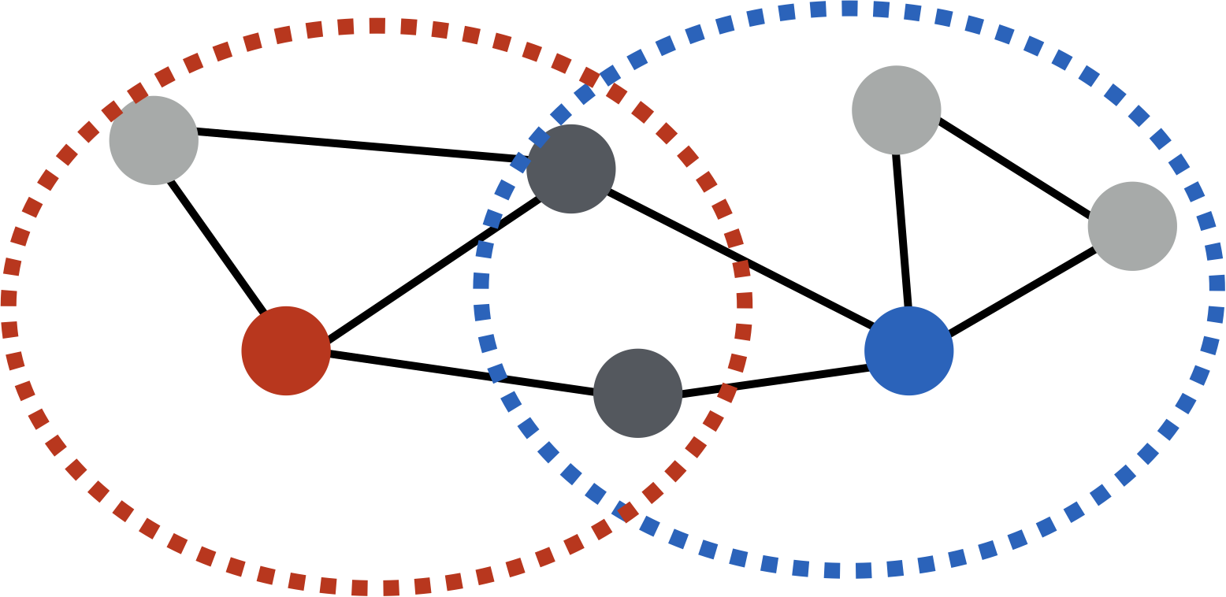
Multi-hop Similarity
Another option: Measure overlap between node neighborhoods.
Example overlap functions:
Jaccard similarity

Slide 39
Multi-hop Similarity
multi-hop network similarity (i.e., any neighborhood overlap measure)
embedding similarity
S_{u,v} is the neighborhood overlap between u and v (e.g., Jaccard overlap or Adamic-Adar score).
This technique is known as HOPE (Yan et al., 2016).

Slide 40
Summary so far
Basic idea so far:
1) Define pairwise node similarities.
2) Optimize low-dimensional embeddings to approximate these pairwise similarities.
Issues:
Expensive: Generally O(|V|²), since we need to iterate over all pairs of nodes.
Brittle: Must hand-design deterministic node similarity measures.
Massive parameter space: O(|V|) parameters

Slide 41
Random Walk Approaches

Slide 42
Random-walk Embeddings
probability that u and v co-occur on a random walk over the network

Slide 43
Random-walk Embeddings
Estimate probability of visiting node v on a random walk starting from node u using some random walk strategy R.
Optimize embeddings to encode these random walk statistics.

Slide 44
Why Random Walks?
Expressivity: Flexible stochastic definition of node similarity that incorporates both local and higher-order neighborhood information.
Efficiency: Do not need to consider all node pairs when training; only need to consider pairs that co-occur on random walks.

Slide 45
Random Walk Optimization
Run short random walks starting from each node on the graph using some strategy R.
For each node u collect N_{R}(u), the multiset* of nodes visited on random walks starting from u.
Optimize embeddings to according to:
* N_{R}(u) can have repeat elements since nodes can be visited multiple times on random walks.

Slide 46
Random Walk Optimization
Intuition: Optimize embeddings to maximize likelihood of random walk co-occurrences.
Parameterize P(v | z_{u}) using softmax:

Slide 47
Random Walk Optimization
Putting things together:
sum over all nodes u
sum over nodes v seen on random walks starting from u
predicted probability of u and v co-occuring on random walk
Optimizing random walk embeddings =
Finding embeddings z_{u} that minimize L

Slide 48
Negative Sampling
Solution: Negative sampling
i.e., instead of normalizing w.r.t. all nodes, just normalize against k random “negative samples”
random distribution over all nodes
sigmoid function

Slide 49
How should we randomly walk?
So far we have described how to optimize embeddings given random walk statistics.
What strategies should we use to run these random walks?
Simplest idea: Just run fixed-length, unbiased random walks starting from each node (i.e., DeepWalk from Perozzi et al., 2013).
But can we do better?

